Slide 1

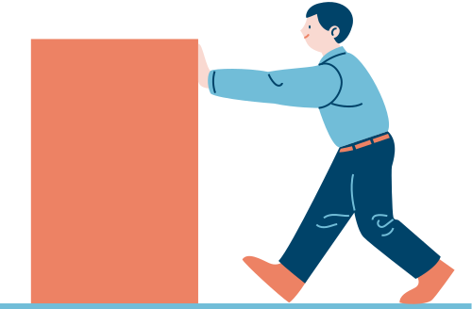

Learn Biomechanics Today, Revolutionize Movement Tomorrow.

Slide 2


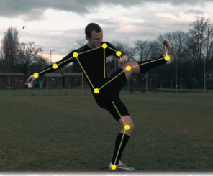
Biomechanics
It studies how living things move, using physics and engineering principles. It applies to sports, medicine (prosthetics, injury prevention), and animal movement. Combining biology and mechanics to improve health, performance, and technology.

Slide 3
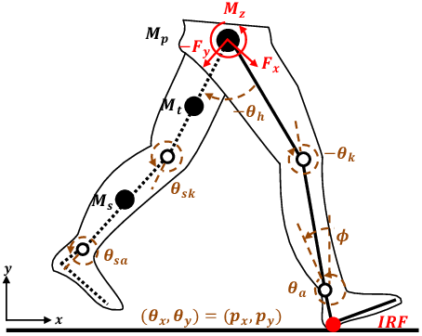
KINEMATICS
Study of motion without considering forces
Focuses on position, displacement, velocity, and acceleration
Analyzes patterns like walking, running, and throwing
Measures stride length, joint angles, and movement speed

Slide 4
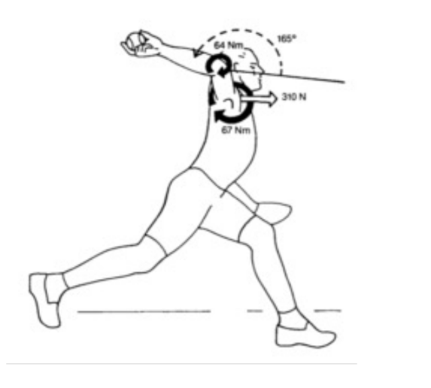
KINETICS
Study of forces that cause or change motion
Focuses on muscle forces, joint loads, and ground reaction forces
Measures torque, energy transfer,and momentum
Analyzes stresses on bones/tendons during movement
Directly applies Newton's Second Law (F=ma):
-Muscle force (F) accelerates body segments
-A greater mass (m) requires more force for the same acceleration

Slide 5
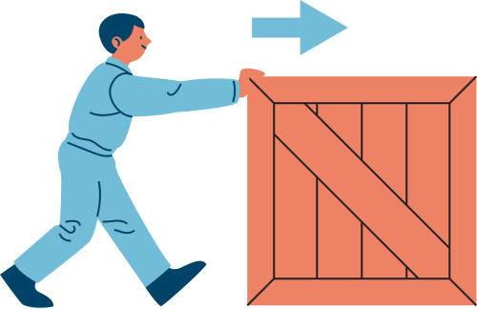
NEWTON SECOND LAW
F = m * a
•Inertia
• Mass moment of inertia
• Acceleration
• Impulse
• Momentum
• Work
• Energy
• Power

Slide 6
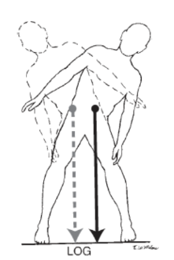
COM & COG
CoM is where body mass is balanced; CoG is where gravity acts (same as CoM on Earth).
Keeps you stable when standing/moving; wrong alignment causes falls or inefficiency.
LoG falls outside your base (e.g., leaning too far) → You lose balance or strain muscles..
IMPORTANCE
WHEN WRONG

Slide 7
JOIN US
BIOPLAY
Your Interactive Guide to Human Motion
CONTENT
We break down Biomechanics concepts with interactive 3D models, real-world examples, and practical explanations. Whether you're studying joint motion (kinematics) or the forces behind movement (kinetics), our content makes it visual and intuitive. No heavy math—just clear insights into how the body works, moves, and sometimes gets injured.
3D-MODELS

Slide 8
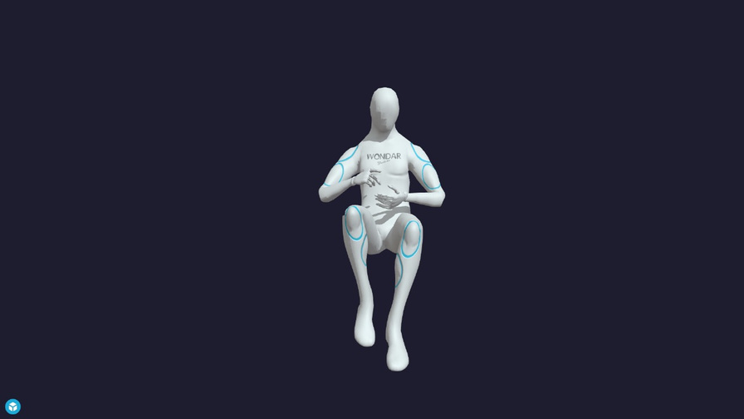
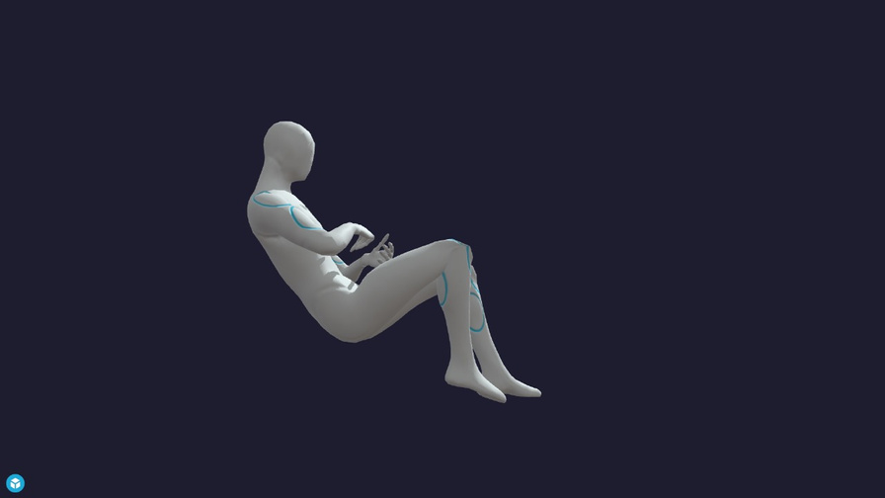
3D-MODELS
Our interactive 3D models let you bring biomechanics to life in a way textbooks never could. Whether you're studying joint movements, muscle forces, or sports techniques, you can now explore the human body in motion by simply clicking, dragging and experimenting. It's like having a biomechanics lab in your pocket.

Slide 9
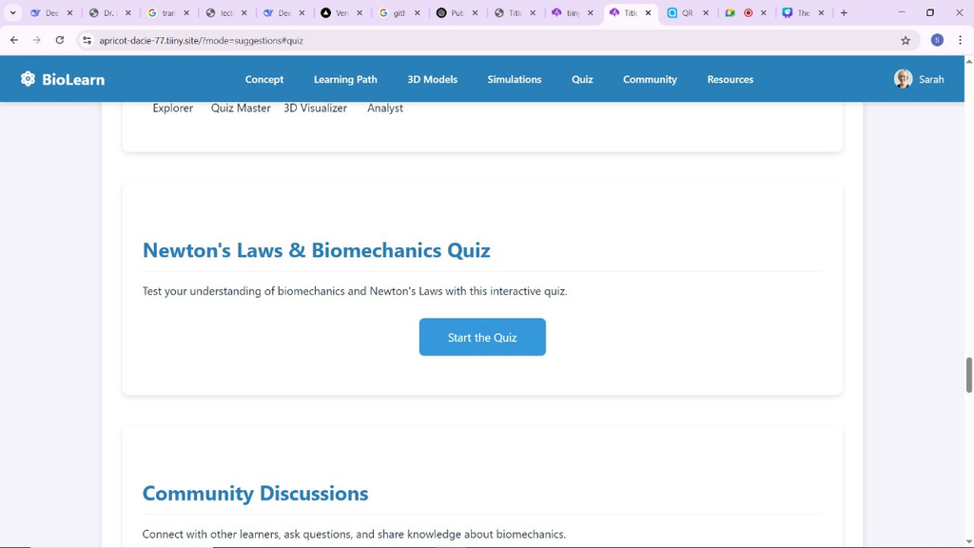
QUIZES
Our quizzes are like a helpful study buddy for biomechanics. They don’t just test you – they explain answers clearly so you actually learn. Get quick feedback, spot where you need improvement, and see how biomechanics works in real life. Great for students, therapists, or anyone who wants to learn by doing.

Slide 10


join us now

Slide 11
WHY BIOPLAY
To make biomechanics simple and interactive—transforming complex concepts (like CoG/Newton’s Laws) into 3D models and real-world examples you can see and experiment with.
Bridge the gap between textbook theory and actionable knowledge—so you can apply biomechanics to training, rehab, or everyday life.
PURPOSE OF THIS WEBSITE
The Goal
understanding forces in your body shouldn’t require a PhD—whether you’re a student, athlete, or just curious about how you move.
WHY IT MATTERS

Slide 12
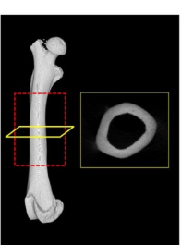
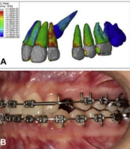
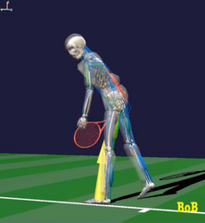
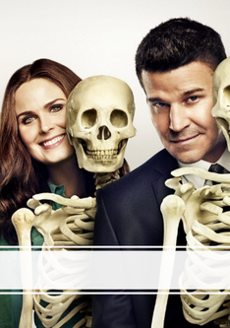
WHY BIOMECHANICS
DIAGNOSIS
TREATMENT
SPORTS
FORENSIC

Slide 13
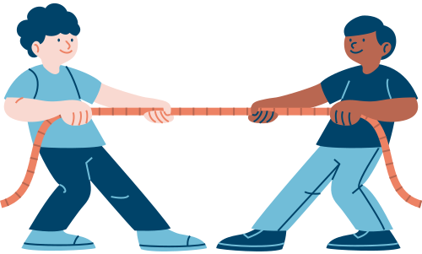
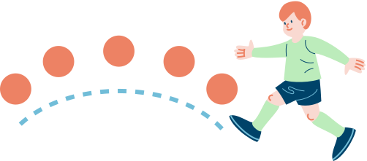
Thank you

Slide 14
References
Miller, T. (2022). "Efficacy of Interactive Biomechanics Tools." J. Biomech. Educ. 15(2), 112-120
Three.js Documentation. (2024). "3D Web Animation Library." https://threejs.org/
Smith, L. (2021). "Newton’s Laws in Human Motion." Biomechanics Today, 8(3), 45-50.

